Slide 1
Lab 8: VAST package
May 17, 2018
Learning objectives:
Interpret multivariate spatio-temporal model results
Gain familiarity with VAST package
Notes:
Model selection blurb
-TMB AIC is marginal AIC– good for predicting within observed random effects (uses number of fixed effects for number of parameters)
-if extrapolating to new random effect values that were not examined, need to use conditional AIC that accounts for the distribution of random effects
-Predictive performance is best measured by cross validation
Jim says—ecological question framed as a model selection question is framed wrong. We always have the wrong model. Plus all combos is too many models to run.
Goodness of fit? Kaspr has some good info, his claim is to simulate data from model and see how likely the data you observed are from there. Jim looks at qq plots, pearson residuals.

Slide 2
Can biogenic habitat be a “proxy” for rockfish habitat?
Steps:
Obtain bottom-trawl data for 8 rockfishes and biogenic habitat (soft corals + sponges)
Fit multispecies model
Interpret covariation
Compare single-species multispecies index of abundance
Thorson, and Barnett. 2017. Comparing estimates of abundance trends and distribution shifts using single- and multispecies models of fishes and biogenic habitat. ICES J. Mar. Sci. J. Cons.
Notes:
What is the effect of untrawlable habitat on estimates of rockfish density?
Structure-forming invertebrates—can we use them as a proxy for an indicator of proximity to rocks, and therefore higher rockfish densities?

Slide 3
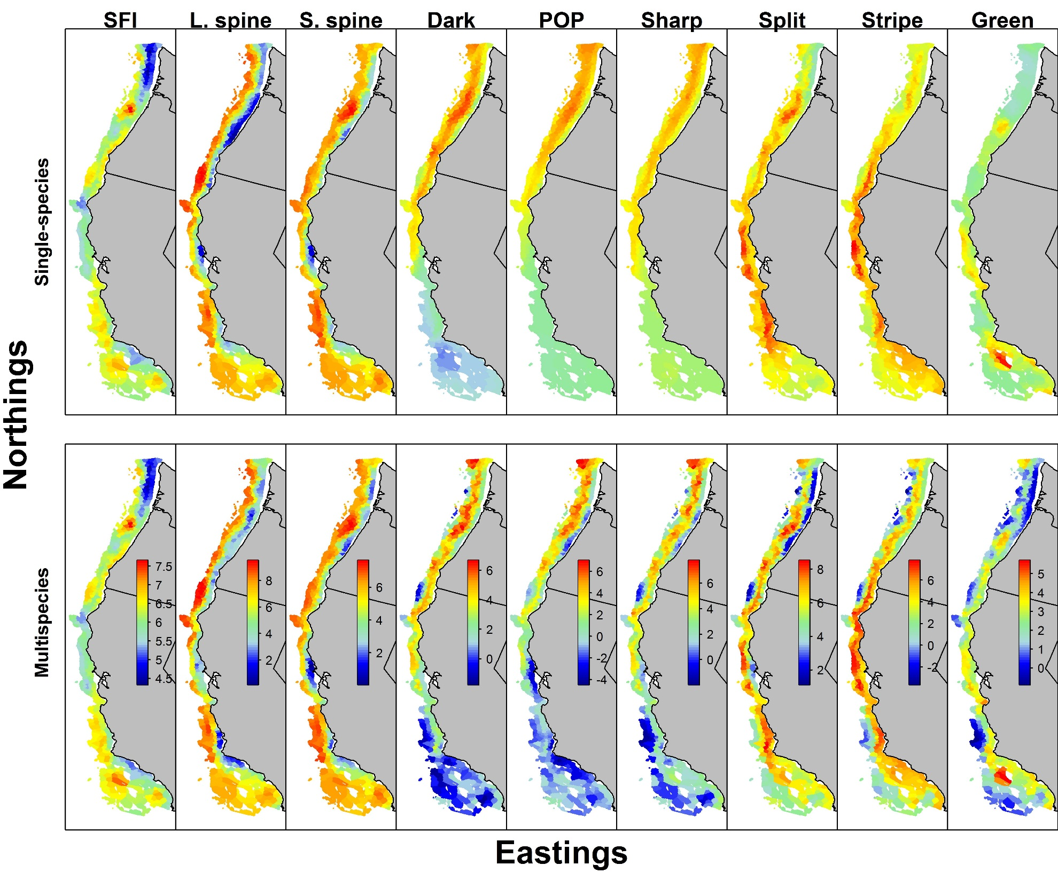
Can biogenic habitat be a “proxy” for rockfish habitat?
Single-species models are strongly smoothed
No fine-scale information for splitnose and sharpchin
Notes:
Averaged across years for simplicity of presentation
DKB and POP sort of uniformly dist by lat. Not enough info

Slide 4
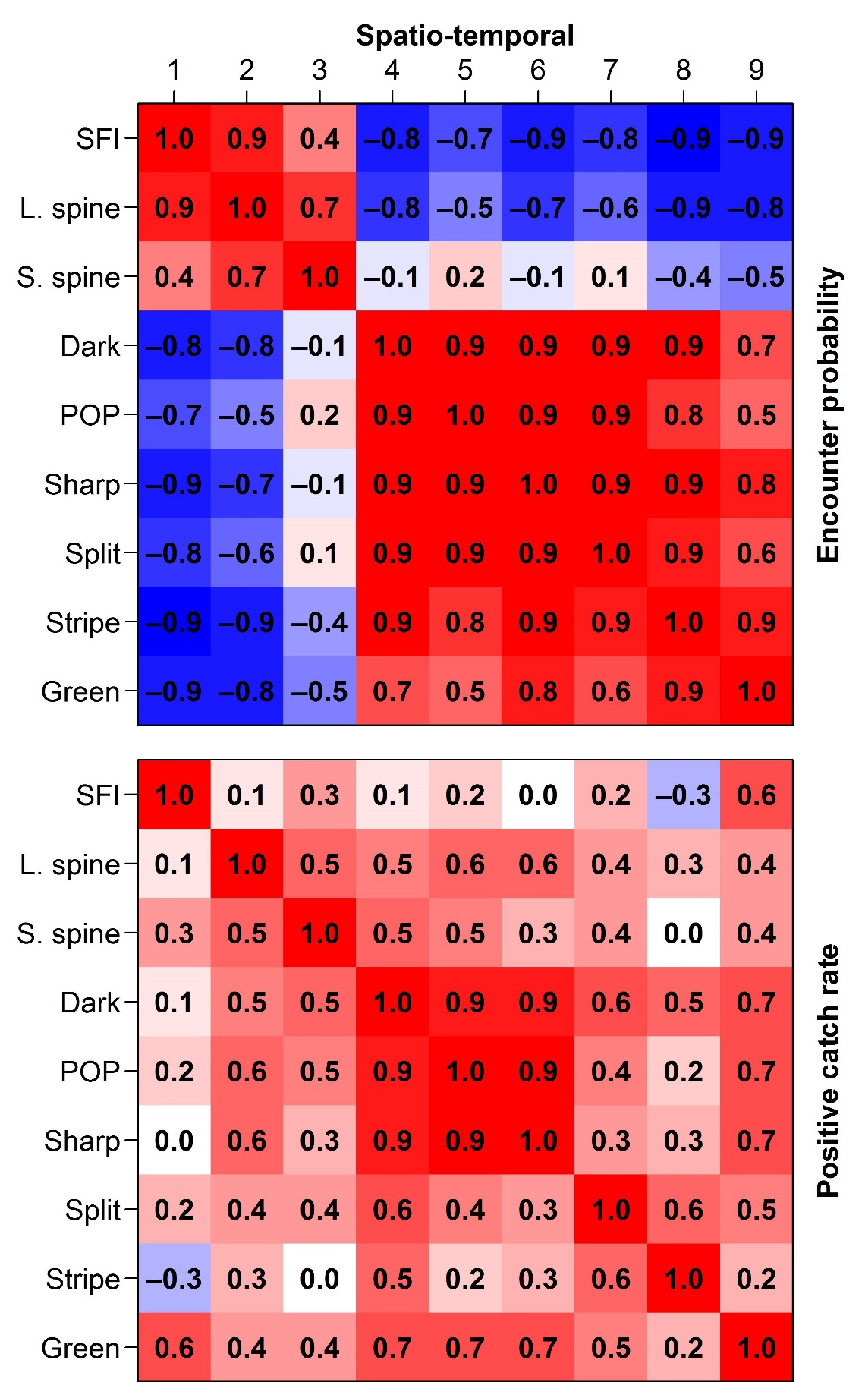

Covariance for spatio-temporal components of encounter probability and positive catch rates
Encounter probability shows two groups
SFI + Thornyheads VS rockfishes
Positive catch rate shows three groups
SFI + Thornyheads VS Northern rockfishes VS Coastwide rockfishes
Correlation: Encounter probability
Correlation: Positive catch rates
Notes:
Use full rank covariance matrix (all the factors) with a delta model and corresponding covariance matrix for each
Kroneker product of space, independent time deviations, full rank cov for species

Slide 5
Can biogenic habitat be a “proxy” for rockfish habitat?
Multispecies model captures fine-scale variation
Shrinks stripetail towards greenstriped
Shrinks POP towards sharpchin
Notes:
Dkb pop and sharp now have more variable distributions—lower density by shore in north

Slide 6
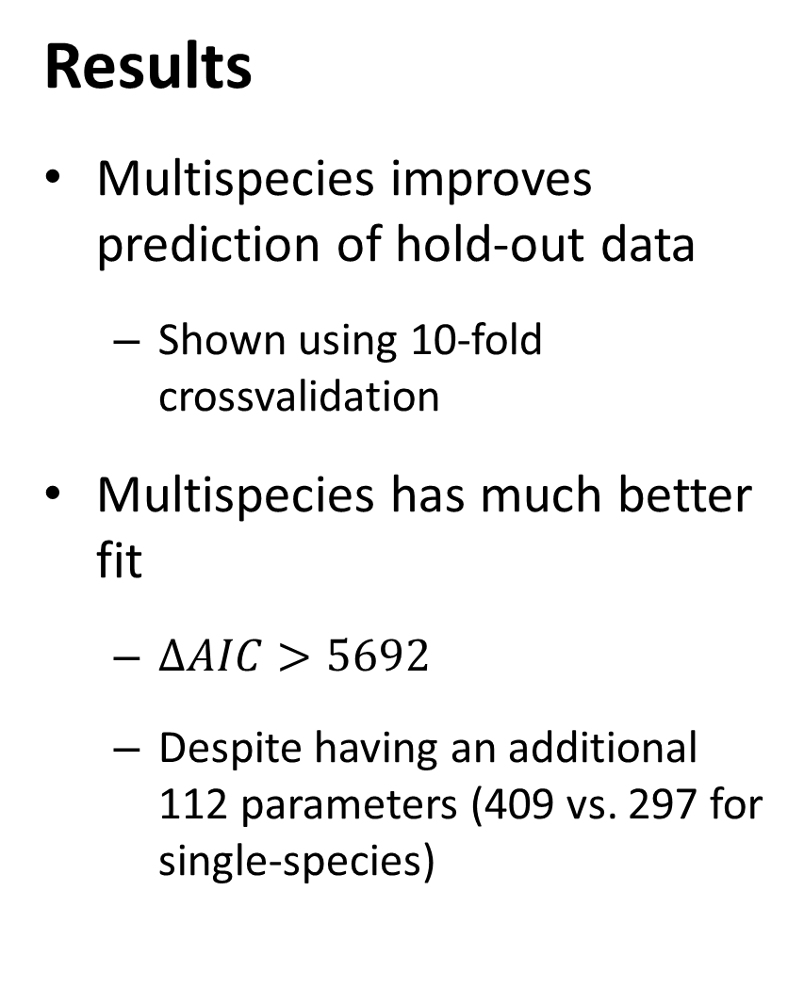
Results
Multispecies improves prediction of hold-out data
Shown using 10-fold crossvalidation
Multispecies has much better fit
$∆AIC>5692$
Despite having an additional 112 parameters (409 vs. 297 for single-species)
10-fold crossvalidation exercise
# | Predictive negative log-likelihood |  | Ratio of predictive probability
 | Single-species VAST model | Multispecies VAST model
1 | 8459.71 | 8078.84 | 1.057
2 | 8560.26 | 8209.90 | 1.053
3 | 8768.53 | 8377.45 | 1.059
4 | 8203.66 | 7815.19 | 1.058
5 | 8335.34 | 8009.96 | 1.049
6 | 8548.48 | 8154.91 | 1.059
7 | 8426.61 | 8133.02 | 1.044
8 | 8688.89 | 8335.62 | 1.052
9 | 8439.27 | 8077.01 | 1.055
10 | 8594.30 | 8271.42 | 1.048
Notes:
Remember that lower tmb OF is better (min negative log likelihood)
How to divide up data for cross validation? This is just at random, some people suggest spatially blocking and leaving out entire areas. Different ways depend on different ways that you want to use the model (eg make inference for new areas, use spatially blocked cross-validation)

Slide 7
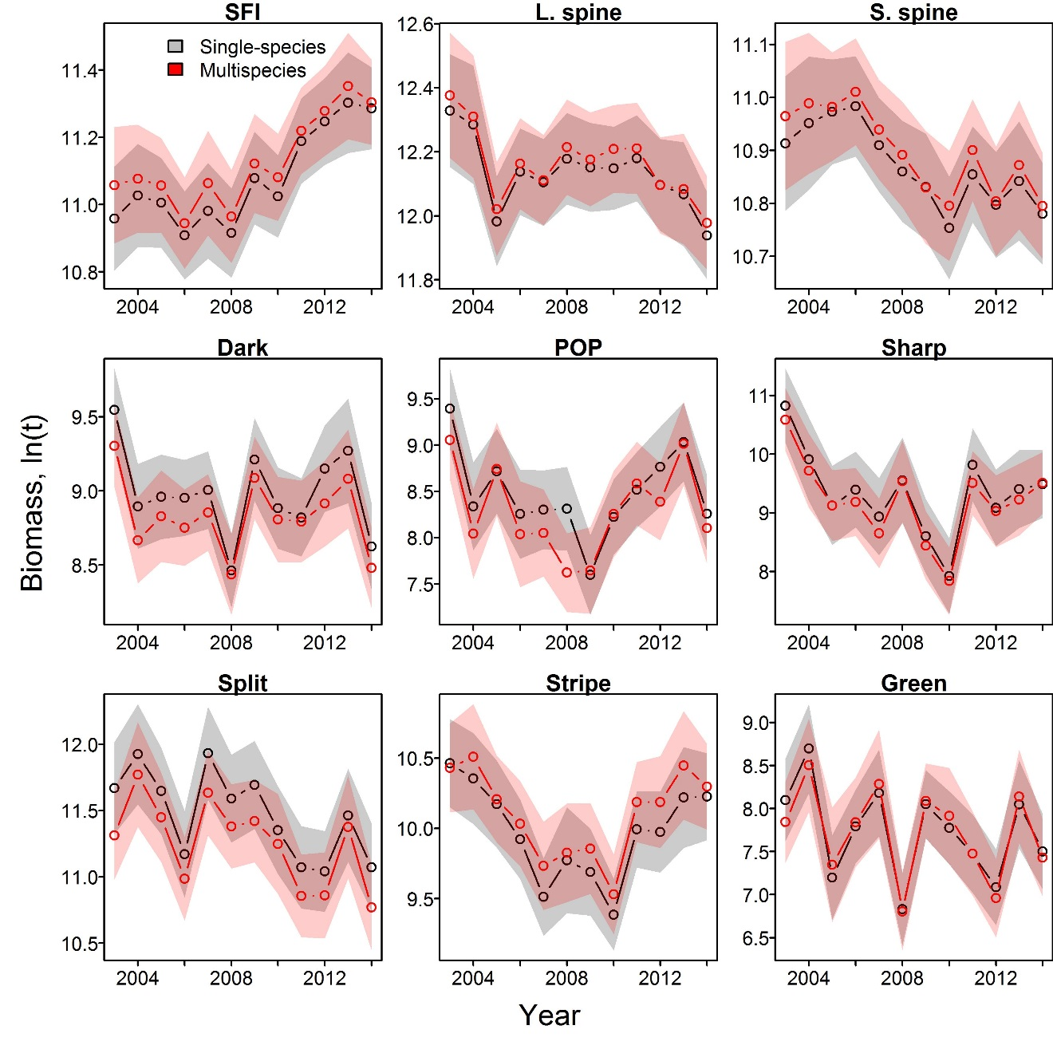
Results
Multispecies model doesn’t shrink intervals
Single-species has very similar standard errors
Indices are largely similar between methods
Makes sense given fixed index for every species-year
Indices of abundance for each species in analysis
Notes:
Won’t make a difference for the mdoels used
Better predictive performance by cross-validation, but SE’s aren’t any lower

Slide 8
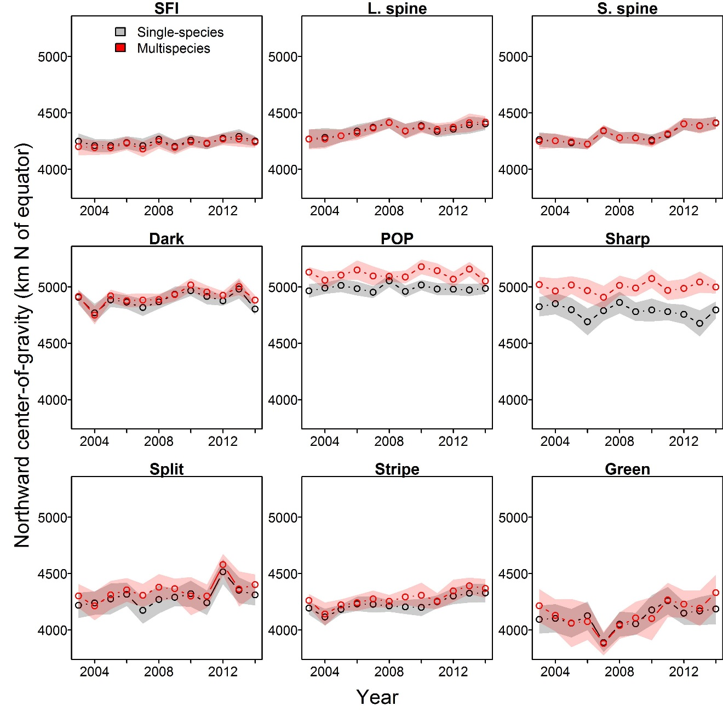
Results
Multispecies model again doesn’t shrink intervals
Multispecies shrinks species towards their group
Large change in COG for POP and sharpchin
Center-of-gravity (km north of equator) for each species
Notes:
More worryingly… center of gravity is affected more for a few species (e.g., further north for pop and sharp)
Don’t use a complicated model to talk about climate unless there’s a huge gain… stick to simple, easy to explain model
Hard to say which is more trustworthy without looking at it more
Good for understanding covariance between species, and improved finescale predicitons in habitat (good for fine scale predictions, density, survey) but not that helpful for index standardization (not many gains)

Slide 9
Recommendations
Multispecies model is useful for…
Understanding covariation among species
Useful information ecologically
Essential fish habitat designation
Improves density predictions
Multispecies model is not useful for…
Index standardization for stock assessment
Adds complexity without improvement in precision
Climate-impact analysis
Too sensitive to model-specification for sensitive science issues
Notes:
Two-stage models (treating model output as data in another output, due to complicated sampling schemes) there is an unusual bias-variance tradeoff. Lots of fisheries models are already biased at low sample sizes, so better to have more precision? But review process is simpler if the outputs from first model are unbiased.

Slide 10
VAST package and FishStats toolbox
Spatio-temporal model
Benefits of single approach
Include biological mechanism
Improved communication
Similar review standards and “burden of proof”
Stock Assessment
Habitat Assessment
Integrated ecosystem assessment
Climate Assessment
Notes:
Circles are dominant legislated tasks for NOAA…but often end up siloed. Can ST models combine them all??

Slide 11

VAST package and FishStats toolbox
www.FishStats.org
FishViz
Visualizes results worldwide
VAST
Multi-species index model
SpatialVAM
Estimate species interactions
FishData
Scrape data worldwide
FishStats-listserv
Community updates by email

Slide 12
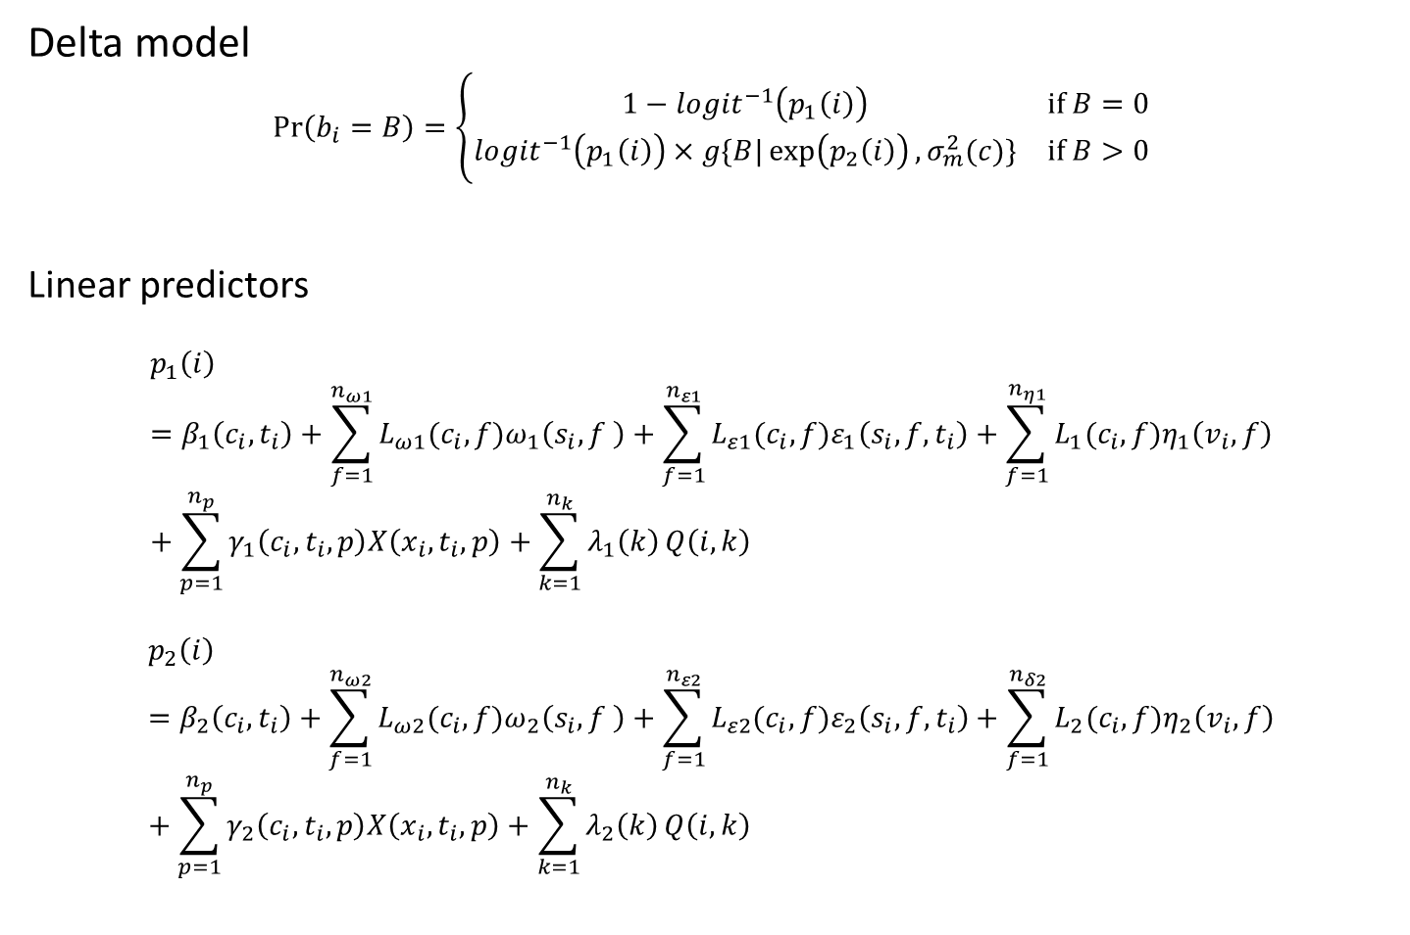
VAST package and FishStats toolbox
Delta model
$$\operatorname{Pr}\left(b_{i}=B\right)=\left\{\begin{matrix}1−logit^{−1}\left(p_{1}\left(i\right)\right) & if B=0 \\ logit^{−1}\left(p_{1}\left(i\right)\right)×g\{\left.B|\exp\left(p_{2}\left(i\right)\right),σ_{m}^{2}(c)\}\right. & if B>0\end{matrix}\right.$$
Linear predictors
$$p_{1}\left(i\right)=β_{1}\left(c_{i},t_{i}\right)+\sum_{f=1}^{n_{ω1}}{L_{ω1}(c_{i}, f)ω_{1}\left(s_{i},f \right)}+\sum_{f=1}^{n_{ε1}}{L_{ε1}(c_{i}, f)ε_{1}\left(s_{i},f,t_{i}\right)}+\sum_{f=1}^{n_{η1}}{L_{1}(c_{i},f)η_{1}\left(v_{i},f\right)}+\sum_{p=1}^{n_{p}}{γ_{1}\left(c_{i}, t_{i},p\right)X\left(x_{i},t_{i},p\right)+\sum_{k=1}^{n_{k}}{λ_{1}\left(k\right)}Q\left(i,k\right)}$$
$$p_{2}\left(i\right)=β_{2}\left(c_{i},t_{i}\right)+\sum_{f=1}^{n_{ω2}}{L_{ω2}(c_{i}, f)ω_{2}\left(s_{i},f \right)}+\sum_{f=1}^{n_{ε2}}{L_{ε2}(c_{i}, f)ε_{2}\left(s_{i},f,t_{i}\right)}+\sum_{f=1}^{n_{δ2}}{L_{2}(c_{i},f)η_{2}\left(v_{i},f\right)}+\sum_{p=1}^{n_{p}}{γ_{2}\left(c_{i}, t_{i},p\right)X\left(x_{i},t_{i},p\right)}+\sum_{k=1}^{n_{k}}{λ_{2}\left(k\right)}Q\left(i,k\right)$$
Notes:
Modeling encounter prob instead of zero prob
Eta is vessel effect for overdispersion (length = nobs) uncorrelated covariance occurring at the sampling level (fine-scale spatio-temporal covariance…finer than scale we’re measuring, maybe/probably due to sampling)
Q is for catchability—process of determining how many species that are there that we actually observe. Maybe like detectability that varies between surveys
Conventional way—beta, L, lambda, fixed; omega, epsilon are random (because of space), eta are random
Remember that L are loadings matrices for multispecies parts

Slide 13
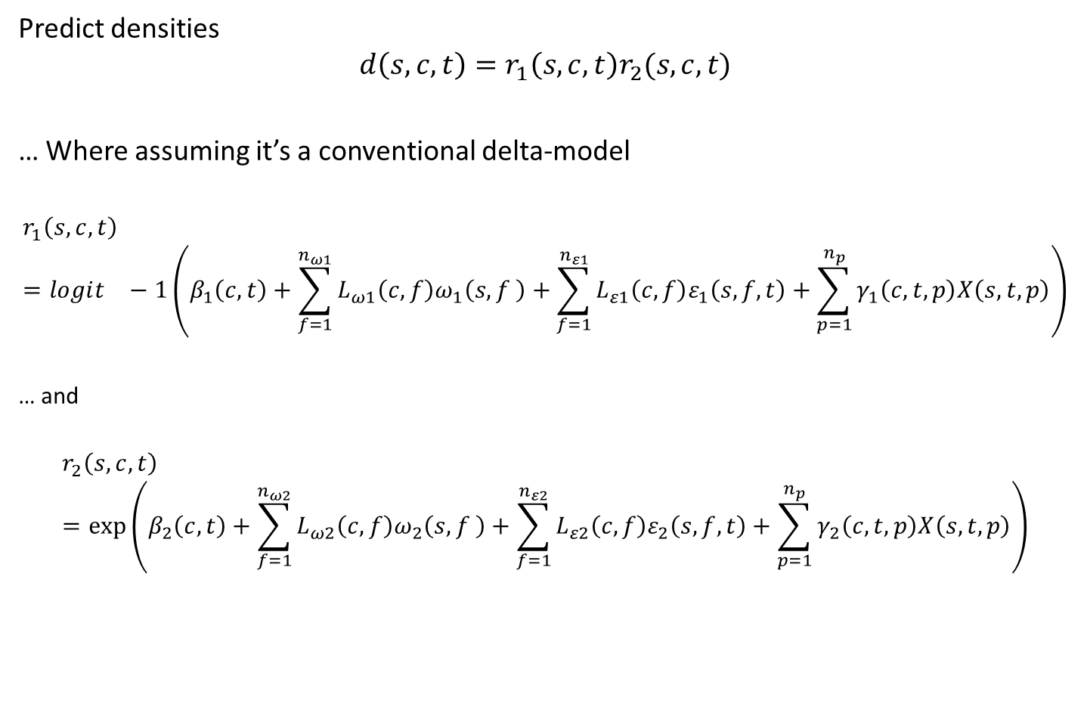
VAST package and FishStats toolbox
Predict densities
$$d\left(s,c,t\right)=r_{1}\left(s,c,t\right)r_{2}(s,c,t)$$
… Where assuming it’s a conventional delta-model
$$r_{1}\left(s,c,t\right)=logit^{}−1\left(β_{1}\left(c,t\right)+\sum_{f=1}^{n_{ω1}}{L_{ω1}\left(c, f\right)ω_{1}\left(s,f \right)}+\sum_{f=1}^{n_{ε1}}{L_{ε1}\left(c, f\right)ε_{1}\left(s,f,t\right)}+\sum_{p=1}^{n_{p}}{γ_{1}\left(c,t,p\right)X\left(s,t,p\right)}\right)$$
… and
$$r_{2}\left(s,c,t\right)=\exp\left(β_{2}\left(c,t\right)+\sum_{f=1}^{n_{ω2}}{L_{ω2}\left(c, f\right)ω_{2}\left(s,f \right)}+\sum_{f=1}^{n_{ε2}}{L_{ε2}\left(c, f\right)ε_{2}\left(s,f,t\right)}+\sum_{p=1}^{n_{p}}{γ_{2}\left(c,t,p\right)X\left(s,t,p\right)}\right)$$
Notes:
Use estimated model values and drop out the portions that are not indexed by space (predicting at some reference value of catchability etc.)
Knots = predicted process interpretation
Density covariates could be put in at finer scale
Linear predictor would change—X is finer spactial scale than knots. Get knot effect at coarser scale and then have covariates at a finer scale (need some bookkeeping)
Could also do a better way of interpolating between points (INLA does continuous, mcgv does splines, whereas vast just assumes constant)
Here assuming that habitat cov are defined at same scale as knots
Maxent guy talked about modeling at coarser scale than biology but have finescale samples, could include and average value (eg average over the area calculation points) or use minimum value( eg min temp for plants) , and variance. Art of biologically relevant covarites for species distribution models
ANOTEHR thought: consider them to be catchability effects?

Slide 14
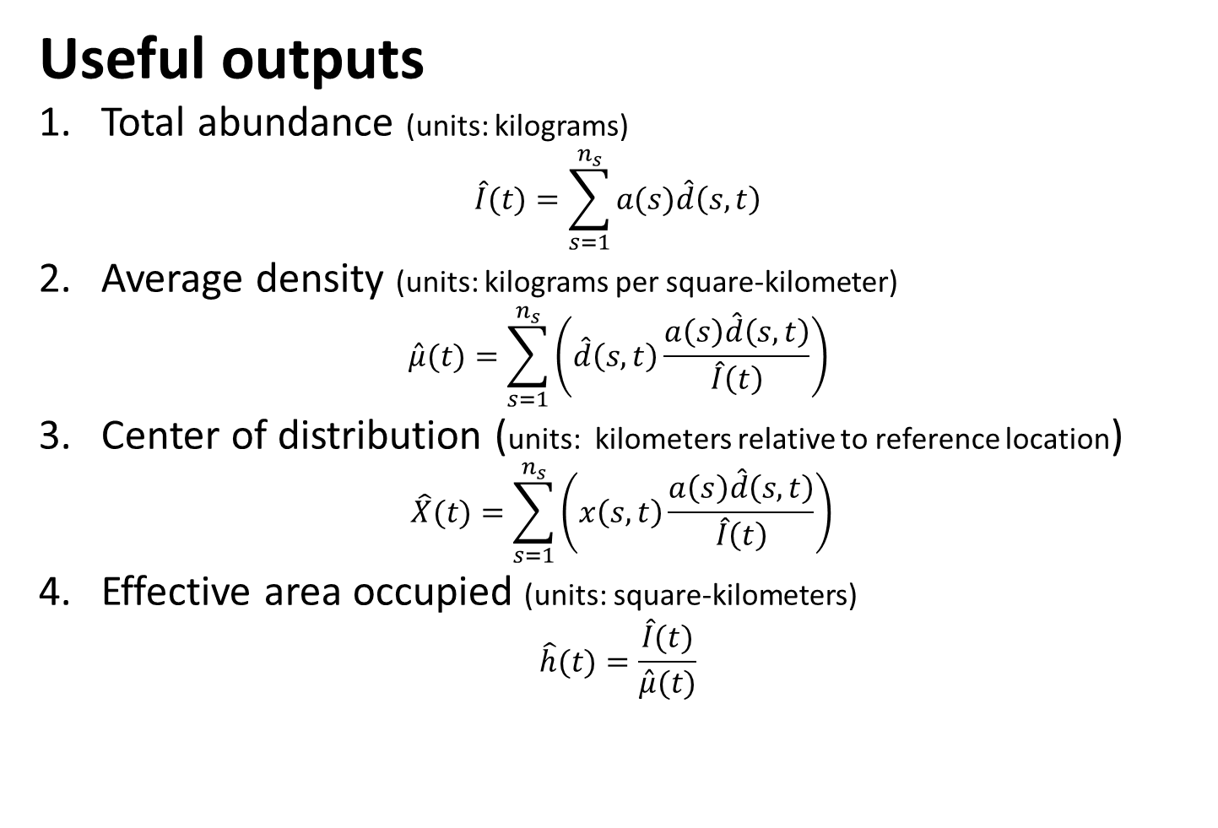
VAST package and FishStats toolbox
Useful outputs
1. Total abundance (units: kilograms)
$$\hat{I}(t)=\sum_{s=1}^{n_{s}}{a(s)\hat{d}\left(s,t\right)}$$
2. Average density (units: kilograms per square-kilometer)
$$\hat{μ}(t)=\sum_{s=1}^{n_{s}}{\left(\hat{d}\left(s,t\right)\frac{a\left(s\right)\hat{d}\left(s,t\right)}{\hat{I}\left(t\right)}\right)}$$
3. Center of distribution (units: kilometers relative to reference location)
$$\hat{X}(t)=\sum_{s=1}^{n_{s}}{\left(x\left(s,t\right)\frac{a\left(s\right)\hat{d}\left(s,t\right)}{\hat{I}\left(t\right)}\right)}$$
4. Effective area occupied (units: square-kilometers)
$$\hat{h}(t)=\frac{\hat{I}(t)}{\hat{μ}(t)}$$
Notes:
N_s knots

Slide 15
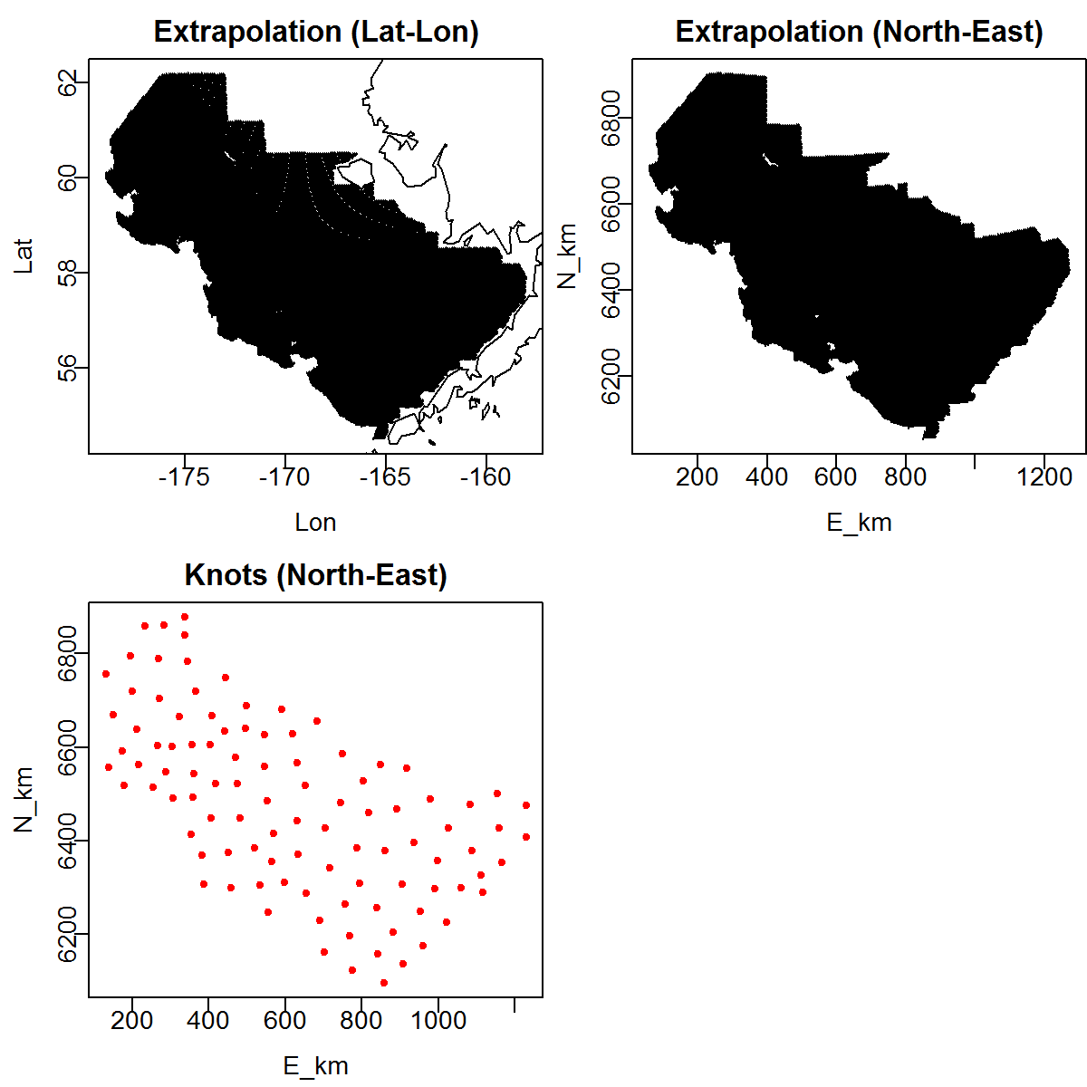
Diagnostics
Advice: Inspect extrapolation footprint and knots

Slide 16
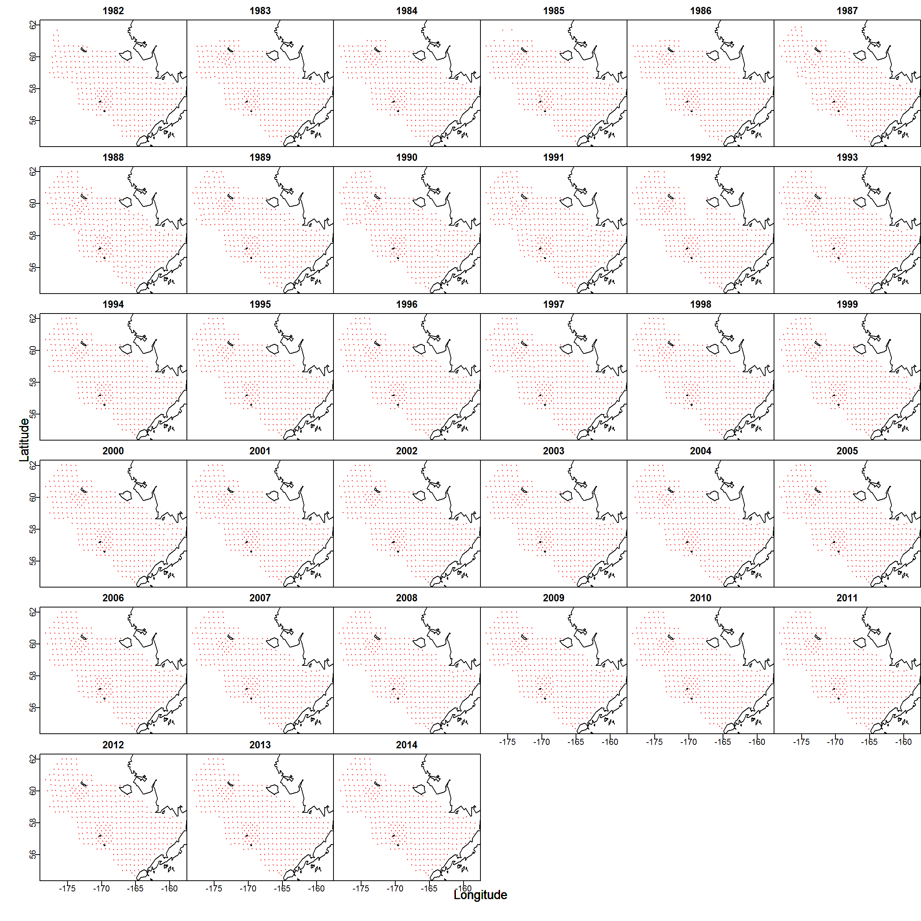
Diagnostics
Advice: Inspect spatial distribution of data
Notes:
Distribution of data—preferential sampling can bias spatial models (check how often/when you are extrapolating to areas with no data)

Slide 17
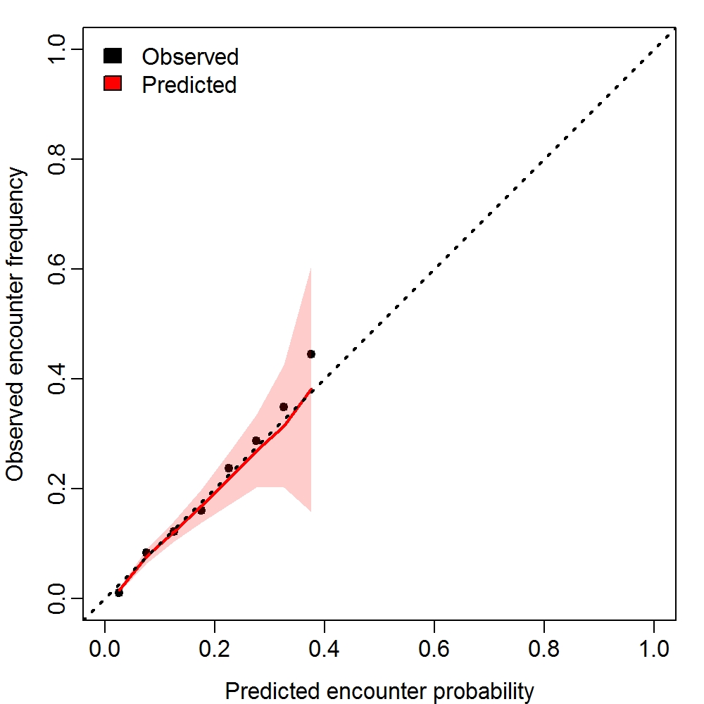
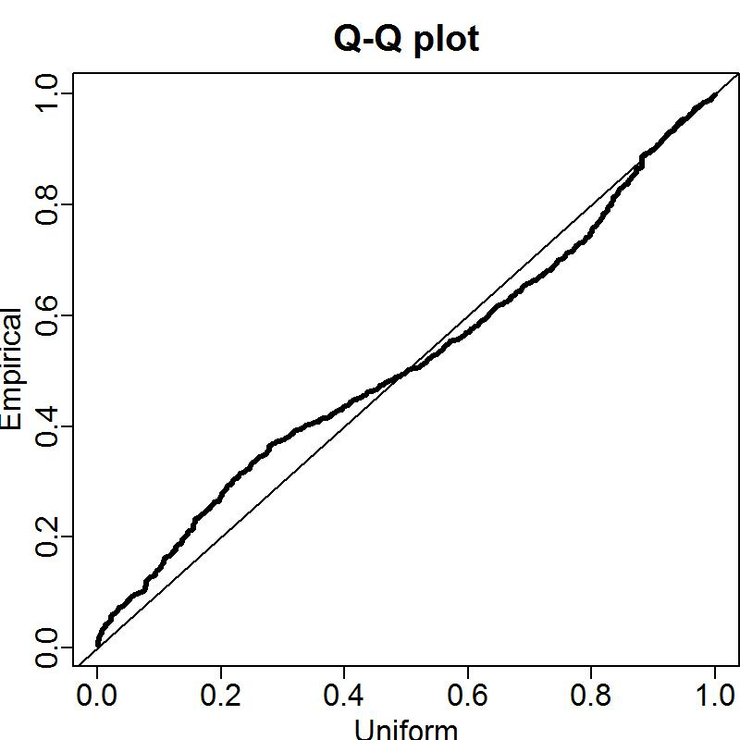
Diagnostics
Encounter probability vs. frequency
Quantile-quantile plot for positive catch rates

Slide 18
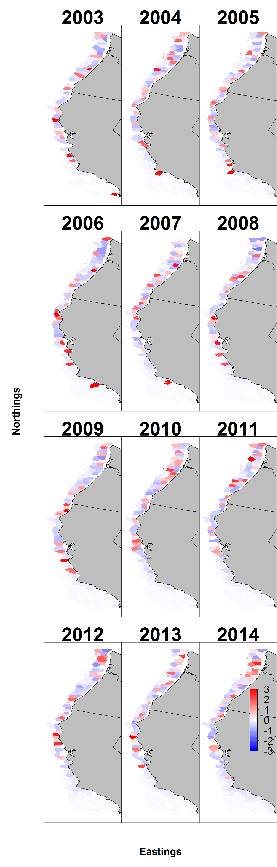
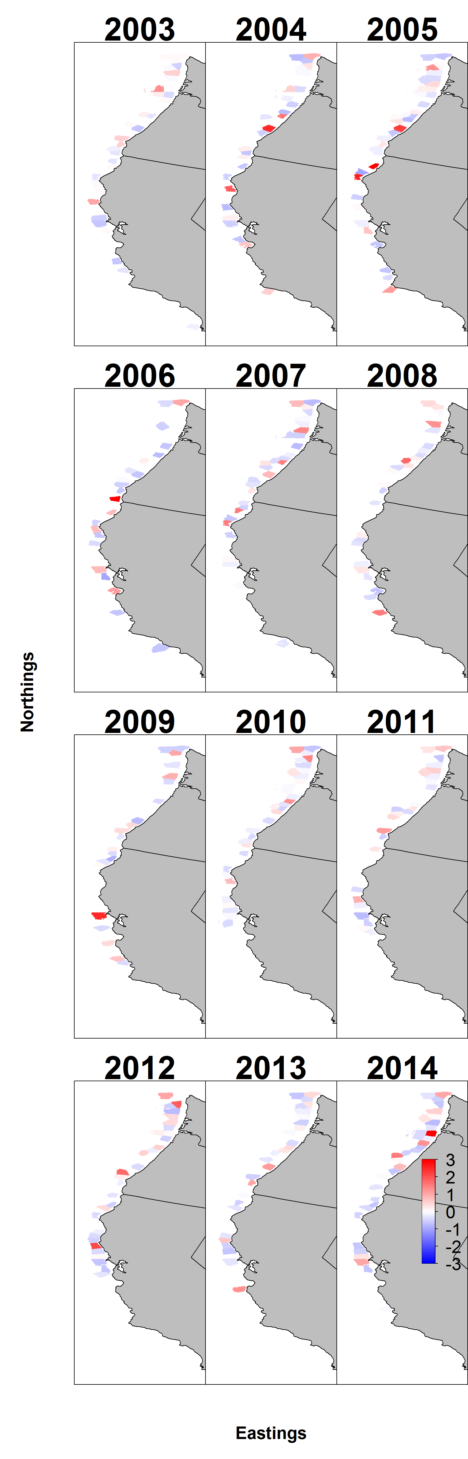
Pearson residuals for encounter
Pearson residuals for positive catch rates
Notes:
Pearson residual- zscored residual (between -2 and 2 ok)
No persistent spatial patterns through time or in blocks (no systematic misses)
Plot a semi-variogram of residuals, or parameteric bootstrap comparisons of model to data

Slide 19
Advice – Look at bounds and gradients
 | Param | starting_value | Lower | MLE | Upper | final_gradient
39 | beta2_ct | 9.21962 | -50 | 7.516834 | 50 | 2.20E-10
40 | beta2_ct | 9.21962 | -50 | 8.739776 | 50 | -1.49E-10
41 | beta2_ct | 9.21962 | -50 | 7.843733 | 50 | 1.06E-09
42 | beta2_ct | 9.21962 | -50 | 8.534672 | 50 | 1.02E-09
43 | beta2_ct | 9.21962 | -50 | 8.097048 | 50 | 1.03E-09
44 | beta2_ct | 9.21962 | -50 | 8.458756 | 50 | 3.47E-10
45 | beta2_ct | 9.21962 | -50 | 8.286936 | 50 | -1.06E-10
46 | beta2_ct | 9.21962 | -50 | 8.242662 | 50 | 2.49E-11
47 | beta2_ct | 9.21962 | -50 | 8.045717 | 50 | 9.28E-10
48 | beta2_ct | 9.21962 | -50 | 8.170187 | 50 | 3.41E-11
49 | beta2_ct | 9.21962 | -50 | 8.06304 | 50 | 9.76E-10
50 | beta2_ct | 9.21962 | -50 | 8.212494 | 50 | -5.63E-10
51 | beta2_ct | 9.21962 | -50 | 8.008228 | 50 | -1.80E-10
52 | beta2_ct | 9.21962 | -50 | 7.516414 | 50 | -7.77E-10
53 | beta2_ct | 9.21962 | -50 | 7.730084 | 50 | -2.10E-10
54 | beta2_ct | 9.21962 | -50 | 7.886746 | 50 | 2.17E-10
55 | beta2_ct | 9.21962 | -50 | 7.662614 | 50 | -5.12E-10
56 | beta2_ct | 9.21962 | -50 | 7.40508 | 50 | 7.91E-10
57 | beta2_ct | 9.21962 | -50 | 8.197652 | 50 | -7.12E-10
58 | beta2_ct | 9.21962 | -50 | 8.165989 | 50 | -2.23E-10
59 | beta2_ct | 9.21962 | -50 | 7.847344 | 50 | -2.63E-09
60 | beta2_ct | 9.21962 | -50 | 8.542195 | 50 | 1.28E-10
61 | beta2_ct | 9.21962 | -50 | 7.982901 | 50 | -1.07E-09
62 | beta2_ct | 9.21962 | -50 | 7.832611 | 50 | -4.09E-10
63 | beta2_ct | 9.21962 | -50 | 7.129841 | 50 | -1.78E-10
64 | beta2_ct | 9.21962 | -50 | 6.996498 | 50 | 4.58E-10
65 | beta2_ct | 9.21962 | -50 | 6.544465 | 50 | -1.44E-09
66 | beta2_ct | 9.21962 | -50 | 6.056259 | 50 | 8.04E-10
67 | beta2_ct | 9.21962 | -50 | 7.290846 | 50 | 1.02E-09
68 | beta2_ct | 9.21962 | -50 | 7.545933 | 50 | 5.06E-10
69 | beta2_ct | 9.21962 | -50 | 7.247531 | 50 | -1.24E-09
70 | beta2_ct | 9.21962 | -50 | 7.513136 | 50 | 1.12E-09
71 | beta2_ct | 9.21962 | -50 | 8.565377 | 50 | -9.49E-10
72 | L_omega2_z | -0.58178 | -50 | -1.10638 | 50 | -9.35E-09
73 | L_epsilon2_z | -0.45241 | -50 | -1.12348 | 50 | 1.43E-07
74 | logkappa2 | -0.10536 | -6.01012 | -4.53498 | -2.57395 | 3.22E-08
75 | logSigmaM | 1.609438 | -50 | 0.168158 | 10 | -2.42E-07
 | Param | starting_value | Lower | MLE | Upper | final_gradient
1 | ln_H_input | 0 | -50 | 0.231528 | 50 | -6.19E-08
2 | ln_H_input | 0 | -50 | -0.96568 | 50 | -8.88E-08
3 | beta1_ct | -4.64096 | -50 | 4.120475 | 50 | 2.44E-09
4 | beta1_ct | -4.64096 | -50 | 4.228782 | 50 | 1.90E-09
5 | beta1_ct | -4.64096 | -50 | 4.322799 | 50 | -5.30E-10
6 | beta1_ct | -4.64096 | -50 | 5.093036 | 50 | 4.60E-09
7 | beta1_ct | -4.64096 | -50 | 5.428053 | 50 | -5.17E-08
8 | beta1_ct | -4.64096 | -50 | 4.105238 | 50 | -2.95E-09
9 | beta1_ct | -4.64096 | -50 | 5.056347 | 50 | 4.29E-09
10 | beta1_ct | -4.64096 | -50 | 4.168261 | 50 | -5.53E-09
11 | beta1_ct | -4.64096 | -50 | 4.333523 | 50 | 7.79E-09
12 | beta1_ct | -4.64096 | -50 | 5.989274 | 50 | -1.02E-08
13 | beta1_ct | -4.64096 | -50 | 4.524008 | 50 | 3.45E-09
14 | beta1_ct | -4.64096 | -50 | 5.265399 | 50 | 3.09E-09
15 | beta1_ct | -4.64096 | -50 | 5.646847 | 50 | -9.95E-11
16 | beta1_ct | -4.64096 | -50 | 4.886118 | 50 | 3.52E-09
17 | beta1_ct | -4.64096 | -50 | 5.073619 | 50 | 4.40E-09
18 | beta1_ct | -4.64096 | -50 | 4.753279 | 50 | 5.61E-09
19 | beta1_ct | -4.64096 | -50 | 4.996536 | 50 | 4.81E-09
20 | beta1_ct | -4.64096 | -50 | 6.218751 | 50 | 1.38E-09
21 | beta1_ct | -4.64096 | -50 | 5.124685 | 50 | -3.66E-09
22 | beta1_ct | -4.64096 | -50 | 5.706784 | 50 | -8.00E-09
23 | beta1_ct | -4.64096 | -50 | 4.80919 | 50 | 4.36E-09
24 | beta1_ct | -4.64096 | -50 | 4.534566 | 50 | 6.15E-09
25 | beta1_ct | -4.64096 | -50 | 5.45406 | 50 | -1.36E-09
26 | beta1_ct | -4.64096 | -50 | 4.746618 | 50 | 4.78E-09
27 | beta1_ct | -4.64096 | -50 | 4.572286 | 50 | 8.21E-09
28 | beta1_ct | -4.64096 | -50 | 4.198098 | 50 | 1.19E-08
29 | beta1_ct | -4.64096 | -50 | 2.877037 | 50 | 1.34E-08
30 | beta1_ct | -4.64096 | -50 | 3.426151 | 50 | 8.29E-09
31 | beta1_ct | -4.64096 | -50 | 2.986486 | 50 | 5.37E-09
32 | beta1_ct | -4.64096 | -50 | 4.659832 | 50 | 4.15E-09
33 | beta1_ct | -4.64096 | -50 | 4.656848 | 50 | 7.09E-09
34 | beta1_ct | -4.64096 | -50 | 5.18952 | 50 | 4.60E-09
35 | beta1_ct | -4.64096 | -50 | 6.231048 | 50 | 1.60E-09
36 | L_omega1_z | -0.83795 | -50 | -1.94641 | 50 | 1.61E-07
37 | L_epsilon1_z | 1.037078 | -50 | 0.975252 | 50 | -3.53E-07
38 | logkappa1 | -0.10536 | -6.01012 | -4.12041 | -2.57395 | 4.33E-07
Notes:
Do a couple more newton steps and get gradients very very small and look at these
For applied audience—make sure there’s absolutely no chance that model isn’t converged
Check that MLEs aren’t near bounds and have moved away from start values

Slide 20
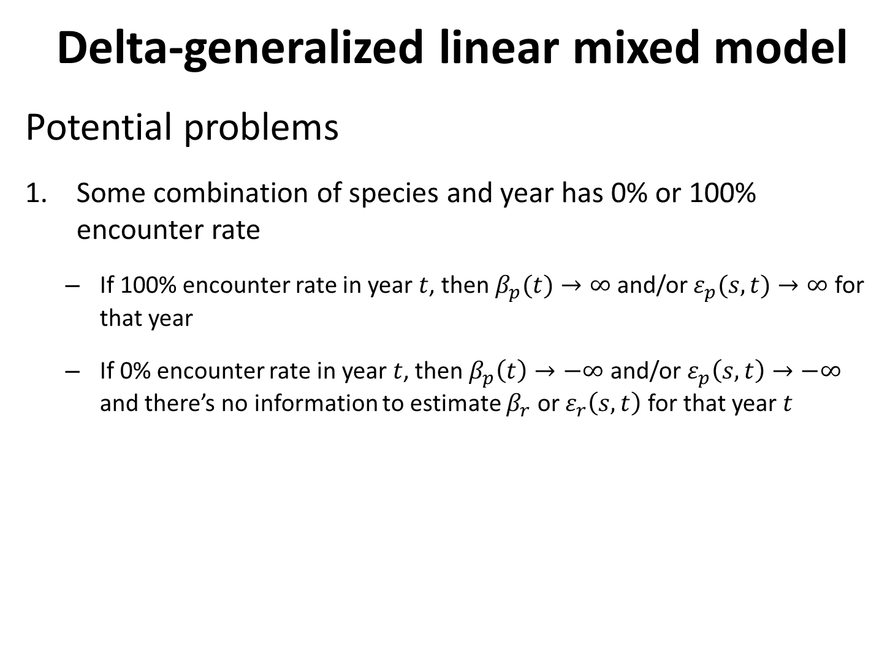
Delta-generalized linear mixed model
Potential problems
Some combination of species and year has 0% or 100% encounter rate
If 100% encounter rate in year $t$, then $β_{p}(t)→∞$ and/or $ε_{p}(s,t)→∞$ for that year
If 0% encounter rate in year $t$, then $β_{p}\left(t\right)→−∞$ and/or $ε_{p}\left(s,t\right)→−∞$ and there’s no information to estimate $β_{r}$ or $ε_{r}\left(s,t\right)$ for that year $t$
Notes:
Complete separation! Not many super satisfying solutions

Slide 21
use ObsModel[2]=3
Delta-generalized linear mixed model
Potential problems
Some combination of species and year has 0% or 100% encounter rate
Solutions
If a few years with 100% encounter rate, try `ObsModel[2]=3`
indicates that VAST should check for species-years combinations with 100% encounter rates and fix those intercept for encounter probability to an extremely high value
If a few years with either 100% of 0% encounter rate, add temporal structure
Shrinks intercept and slope towards adjacent years
Four other special cases available

Slide 22
use ObsModel[2]=3
Delta-generalized linear mixed model
Potential problems
Parameters hit bounds
Solutions
Simplify model
Check parameter estimates when turning off standard errors and newtonstep
Identify parameter at bounds
E.g., ` ln_H_input` sometimes gets to strange values
Turn off using `Data_Fn( …, Aniso=FALSE )

Slide 23
VAST package and FishStats toolbox
[Look at single-species Rmarkdown script: https://github.com/James-Thorson/VAST/tree/master/examples]
[Look at multi-species Rmarkdown script: https://github.com/James-Thorson/VAST/tree/master/examples]

